Slide 1
Faculty Management System
Linked List Based CRUD Operations
Using C Programming
Student Name: Rama NIKHITA , THRIGUN
Register Number:1731,1719
Department: SCDS

Slide 2
Problem Statement
Managing faculty records manually is difficult
Need system to add, delete, update, search, display faculty
Data should be stored dynamically
Linked list used for efficient management

Slide 3
Real-world Application
Used in college faculty management
Used in school teacher records
Used in HR employee systems
Used in office staff database

Slide 4
Data Structure Used
Linked List (Singly Linked List)
Explanation: Node → Represents faculty Pointer → Connects next faculty
Structure Used: struct Faculty → stores faculty details next pointer → stores address of next node
Each node contains: Faculty ID, Name, Department, Designation, Salary

Slide 5
System Design
Faculty stored using linked list Each faculty connected using pointer Head pointer stores first faculty
System Flow: User Input → Processing → Linked List Operation → Output Display
Operations: Add Faculty, Delete Faculty, Update Faculty, Search Faculty, Display Faculty

Slide 6
Algorithm
Add → Create node and insert
Delete → Search ID and remove
Update → Modify details
Search → Traverse list
Display → Print all nodes
Exit → Stop program

Slide 7
Implementation
Programming Language: C
Concepts used: Structures (struct) Pointers Linked List Dynamic memory allocation (malloc, free) Functions Menu-driven program
Functions Used: addFaculty() deleteFaculty() updateFaculty() searchFaculty() displayFaculty()

Slide 8
Features
Add faculty
Delete faculty
Update faculty
Search faculty
Display faculty
Dynamic memory allocation

Slide 9
Demo Output
1. Add Faculty
Enter ID, Name, Dept, Designation, Salary
Faculty added successfully
Display shows all faculty records

Slide 10
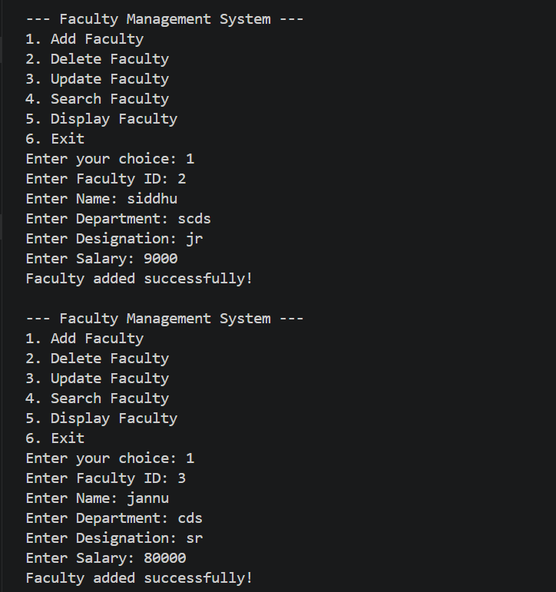
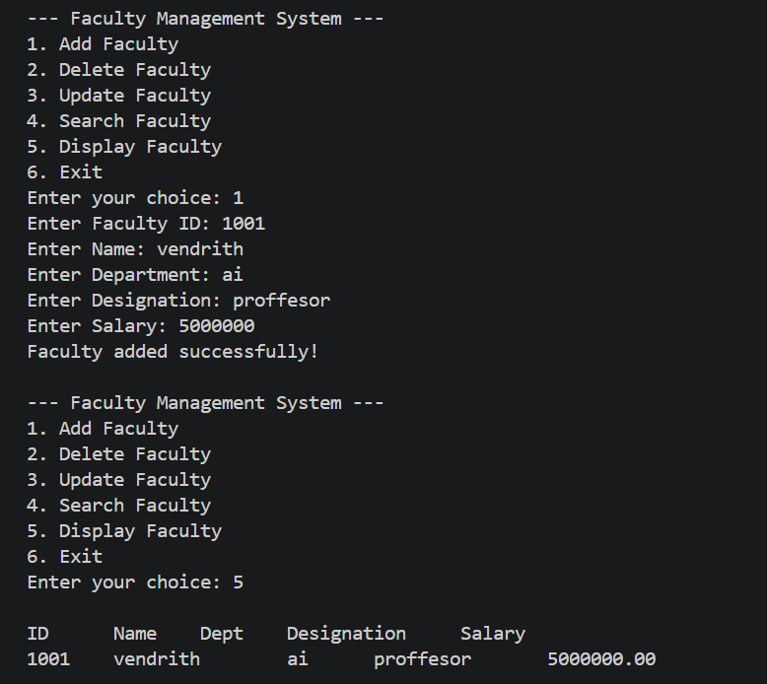

Slide 11
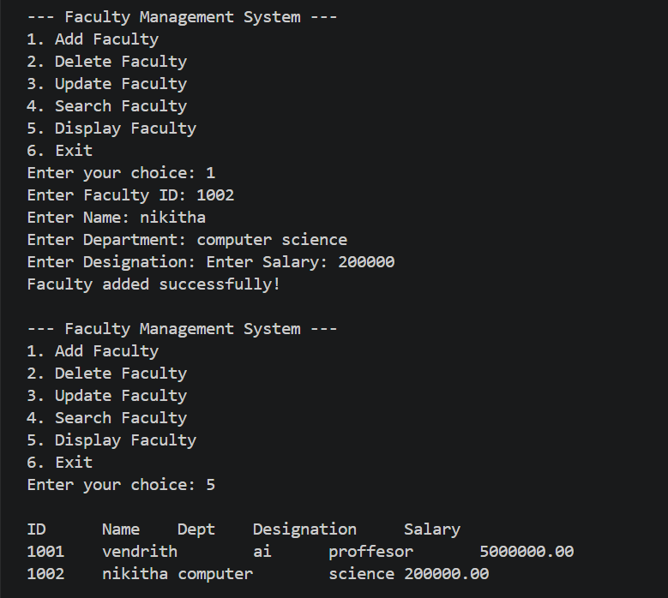
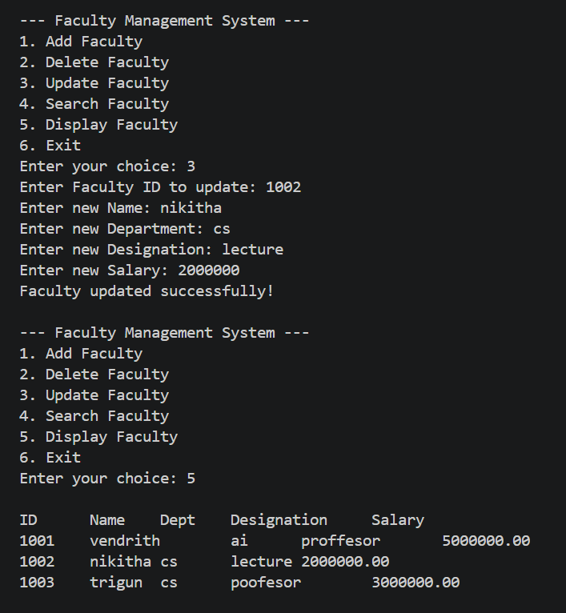

Slide 12
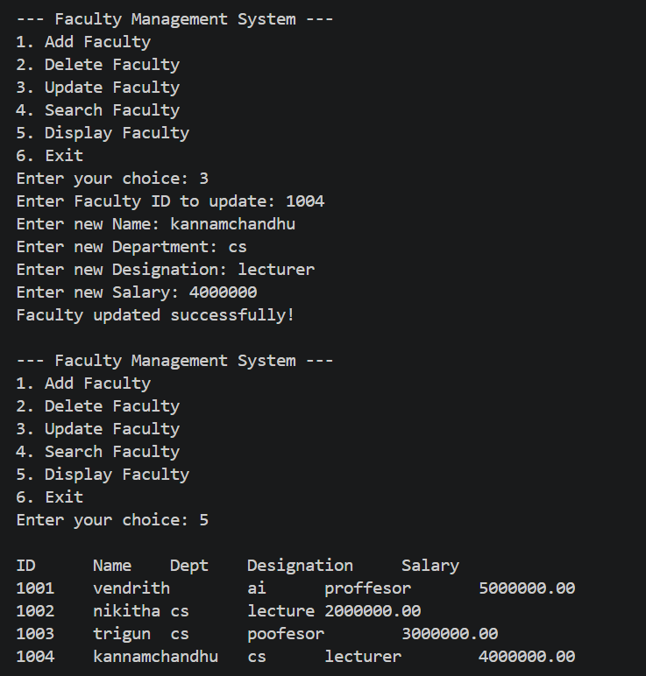
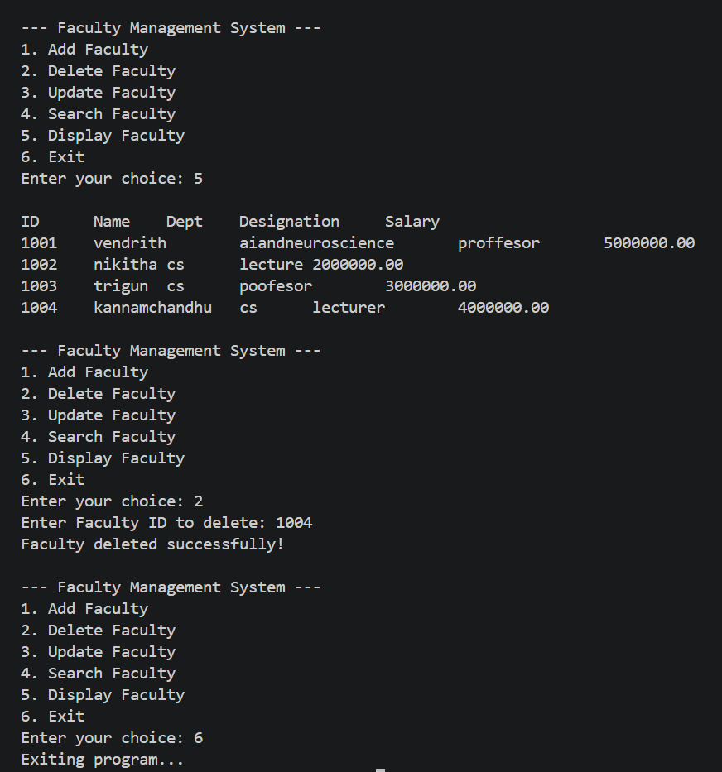

Slide 13
Advantages
Dynamic memory usage
Easy insertion and deletion
No fixed size limitation
User friendly

Slide 14
Conclusion
Faculty Management System implemented
Linked list used for dynamic storage
CRUD operations performed
Useful for real-world applications

